Slide 1

Challenges and Disparities Faced by LGBTQ+ Students in the Transition to College Survey Evidence from the California High School Class of 2023
Christina Sun
With Alexandria Hurtt, Michal Kurlaender, Kairo Weber, and Baiyu Zhou
University of California, Davis
Note: This research was supported by the College Futures Foundation and conducted in partnership with the California Student Aid Commission. The authors are also grateful for ongoing support from the Stuart Foundation to the California Education Lab. The California Education Lab at the University of California, Davis and Policy Analysis for California Education are also thankful for research dissemination support from the Bill & Melinda Gates Foundation. The findings and conclusions here are those of the authors alone and do not necessarily reflect the positions or policies of the funders or of the California Student Aid Commission.

Slide 2
Acknowledgements
California Student Aid Commission
Marlene Garcia
Jessica Moldoff
Ryan Fuller
California Department of Education
California Education Lab
Elizabeth Friedmann
Sherrie Reed
Paco Martorell
Scott Carrell

Slide 3
Overview
This project is the first to utilize a large student survey to explore high school student experiences and postsecondary plans by a diverse set of gender identities and sexual orientations.
Motivation
Methodology
Data
Findings
Discussion

Slide 4
Motivation
The high school to college transition is crucial for young adults (Luh et al., 2023)
Schools shape students’ perceptions of college and future educational attainment (Lynn et al., 2010; Uwah et al., 2008)
Existing research documents differences in outcomes among historically underserved groups
Limited evidence regarding LGBTQ+ students
Research tends to consider the community as a whole
This study provides direct descriptive evidence on LGBTQ+ students’ experiences before college, and examine subgroup differences within the community
Notes:
Research tends to consider the LGBTQ+ community as whole rather than examine subgroup differences based on sexual orientation or gender identity
From Feldman (2022): “This practice creates the problematic ideology that supporting gay and lesbian students looks the same as supporting transgender students. In addition, this practice assumes that various sexual minority groups face the same difficulties and have the same needs.”
The transgender and non-binary experience has been overlooked in education research (Glavinic, 2010; Goldberg & Kuvalanka, 2018; Marine, 2017).

Slide 5
Literature Review
Gender and sexual minority students experience differences in outcomes compared to their cisgender, heterosexual peers
Academic performance, including college admission (Aragon et al., 2014; Feldman et al., 2022; Wilkinson et al., 2021)
Mental health (Kirsch et al., 2015; Marshal et al., 2011)
Transgender youth often face additional barriers to educational success, including bullying/harassment and genderist practices (Marine, 2017)
Differential impact of COVID-19
Compounded difficult relationships between gender and sexual minority youth and rejecting parents (Fish et al., 2020)
Notes:
Marine (2017) argued that “genderism occurs at three critical junctures in the pathway to college. First, high school guidance counsellors may not have training to allow them to better advocate for, affirm, and support transgender students. Second, genderism permeates the college application process, as students are required to self-identify their gender with limited choices such as “male”, “female”, and at best, “other”. The third occurs in the transition to and engagement in college, which still contains gendered practices, such as institutional forms, intercollegiate athletics, residence life, and health insurance forms.”

Slide 6
Institutional and Social Context
COVID-19 Pandemic
Remote start to high school
Significant portion of high school was conducted online
Policy changes in financial aid application submission
AB 469 (2021) mandates graduating high school seniors to complete a FAFSA or CADAA (with opt-out waivers)
Class of 2023 is first cohort

Slide 7
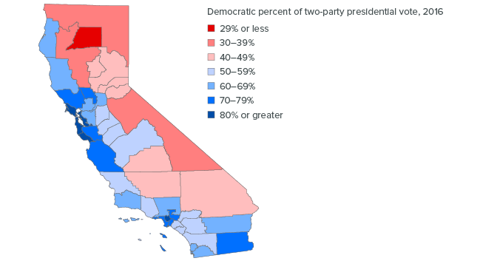
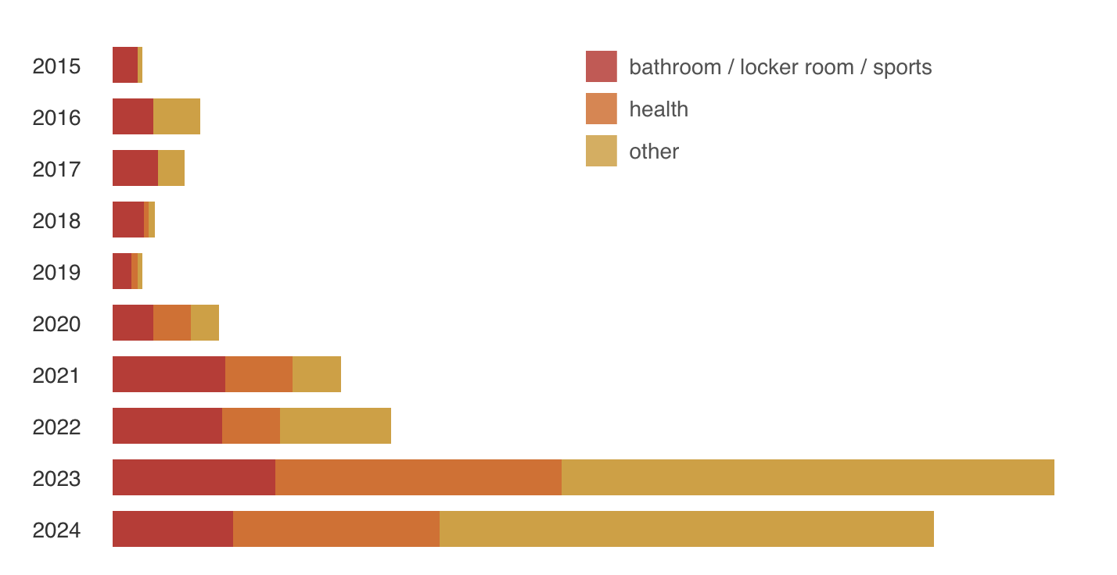
Institutional and Social Context
Heightened visibility of and backlash against LGBTQ+ people
Number of anti-trans bills in the US
Study conducted in California
Diverse demographics and political leanings
Rise of anti-trans hate groups like “Moms for Liberty”
Sources: Trans Legislation Tracker (translegislation.com) and Public Policy Institute of California

Slide 8
Research Questions
How do high school students today define their own gender identity and sexual orientation?
Are there different patterns in experiences and aspirations among sexual and gender minority students?
What are the challenges faced by sexual and gender minority students in the transition to college?

Slide 9
Contributions
Use validated survey instruments to collect nuanced data on gender identity and sexual orientation from a large sample of high school seniors
Recent surveys tend to draw on a narrow sample of students, students predominantly enrolled in earlier grades, or data collected pre-pandemic (Austin et al., 2023; Horowitz & Graf, 2019; Kosciw et al., 2022; Reber & Smith, 2023; YouScience, 2023)
Add to the growing literature on the academic and social experiences of LGBTQ+ students in high school and college (e.g., Austin et al., 2023; Feldman et al., 2023; Kosciw et al., 2022; Reber & Smith, 2023)
Contribute to the broader literature on the transition to college by adding new evidence on the experiences of underserved students

Slide 10
Methodology
Launched an internet-based survey in May 2023 in partnership with the California Student Aid Commission (CSAC)
Distributed by email to all high school seniors in California that submitted a Free Application for Federal Student Aid (FAFSA) or California Dream Act Application (CADAA) for the 2023-24 academic year
Response rate of 3.5%, yet the sample represents a diverse group of students from many different backgrounds and geographic regions throughout the state
Convenience sample but large
The survey’s main components were questions that gather evidence on student experiences navigating the financial aid system
We included questions on social and academic experiences to provide broader and more diverse evidence on student life

Slide 11
Methodology
Likert-scale questions
Students’ high school experiences, college preparation and plans, concerns about college
Demographic questions
Open-ended questions
Perceived challenges and excitement about college

Slide 12
Sample Characteristics
 |  | Survey Respondents |  | Statewide
 |  | N | Percent | N | Percent
Total |  | 10,221 | - | 488936 | -
Race/ethnicity
 | American Indian/Alaskan Native/Pacific Islander | 247 | 2.42 | 2349 | 0.48
 | Black/African American | 559 | 5.47 | 23852 | 4.88
 | Hispanic/Latinx | 4066 | 39.78 | 272323 | 55.70
 | Filipino | 244 | 2.39 | 13231 | 2.71
 | Asian | 1163 | 11.38 | 46278 | 9.47
 | Other | 198 | 1.94 | 17435 | 3.57
 | White/Non-Hispanic | 1553 | 15.19 | 103787 | 21.23
 | Not reported | 2191 | 21.44 | 7576 | 1.55
Gender
 | Cis woman | 4503 | 44.06 | Female | 48
 | Cis man | 2864 | 28.02 | Male | 51.5
 | Non-binary/Gender variant | 418 | 4.09 | Non-binary | < 0.5
 | Unsure/prefer not to say | 191 | 1.87
 | Not reported | 2245 | 21.96
Parent level of education
 | Did not complete high school | 1467 | 14.35
 | High school diploma | 1708 | 16.71
 | Some college, no college degree | 1023 | 10.01
 | Associate degree | 474 | 4.64
 | Bachelor's degree | 1394 | 13.64
 | Graduate/professional degree | 1485 | 14.53
 | Don't know | 447 | 4.37
 | Not reported | 2223 | 21.75
Compared to all 12th graders enrolled in California public high schools, our sample:
Overrepresents American Indian/Alaskan Native/Pacific Islanders
Overrepresents Black/African Americans
Underrepresents Hispanic/Latinx students
The state only includes 3 categories for the gender identity information it collects:
Male
Female
Non-binary

Slide 13
Data
The raw sample includes a total of 10,221 complete responses
Our sample includes around 9,230 college-bound HS seniors
7,522 who reported gender identity
7,481 who reported sexual orientation
Our sample includes 1,828 LGBTQ+ students (excluding Prefer Not to Say)
417 who we classify as being non-cisgender
1,782 who we classify as being non-heterosexual

Slide 14
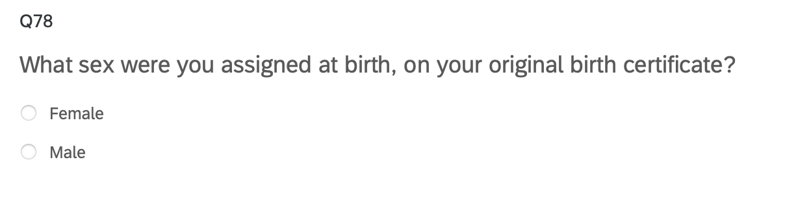
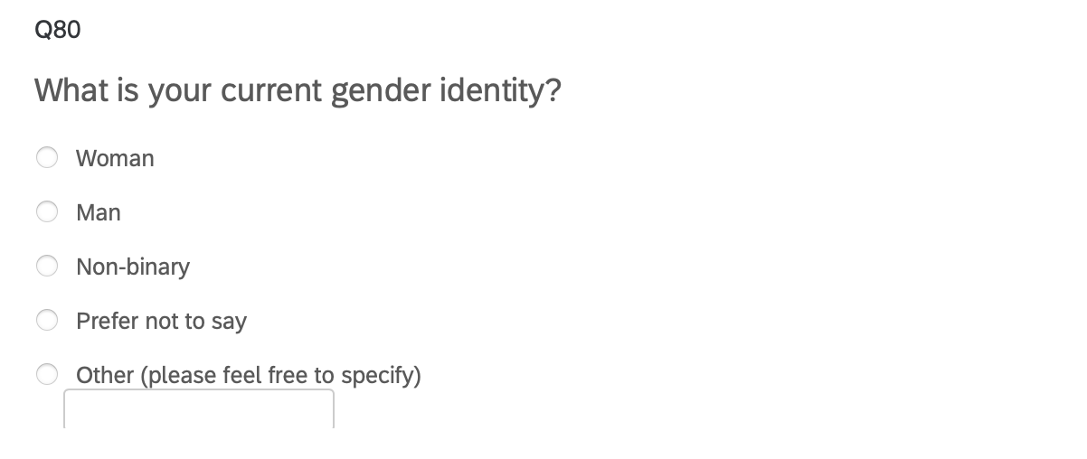
Classification of Gender Identity
“Two-Step” Approach recommended by the Williams Institute

Slide 15
Classification of Gender Identity
Assigned Sex at Birth | Current Gender | Gender Identity Classification
Male | Man | Cisgender Man
Female | Woman | Cisgender Woman
Male | Woman | (Binary) Transgender Woman | (Binary) Transgender
Female | Man | (Binary) Transgender Man
Any | Non-binary/Self Describe/Questioning | Non-binary/Gender Diverse/Questioning
Any | Prefer not to say/Attack helicopters | Prefer not to say

Slide 16
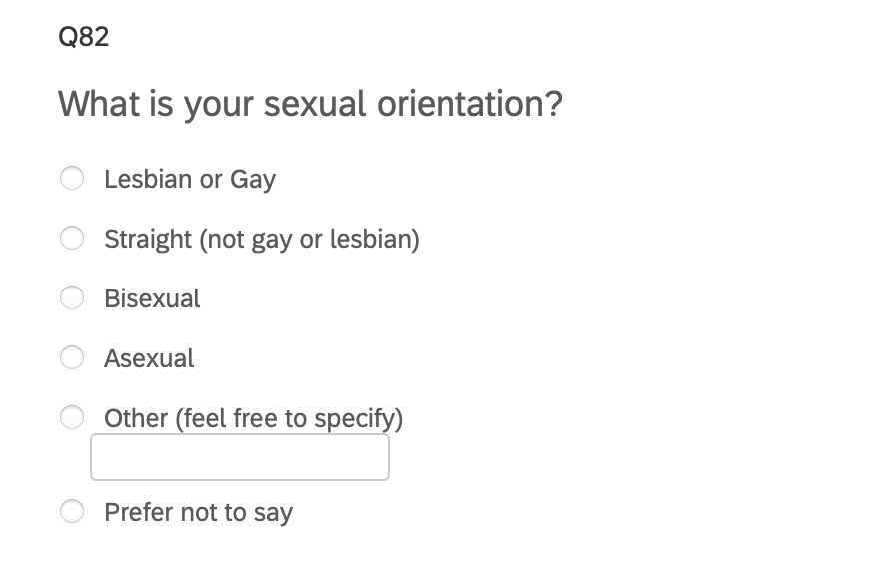
Classification of Sexual Orientation
Adapted from recommendations by the Williams Institute to allow for a broader range of expressions

Slide 17
Classification of Sexual Orientation
Sexual Orientation | Sexual Orientation Classification
Lesbian or Gay | Gay/Lesbian
Straight (not gay or lesbian) | Heterosexual
Bisexual/Self described pansexual | Bisexual/Pansexual
Asexual/Self described asexual/demisexual/aromantic | Asexual/Demisexual/Aromantic
Self described other non-heterosexual orientations/questioning | Other/Queer/Questioning
Prefer not to say/Attack helicopters | Prefer not to say

Slide 18
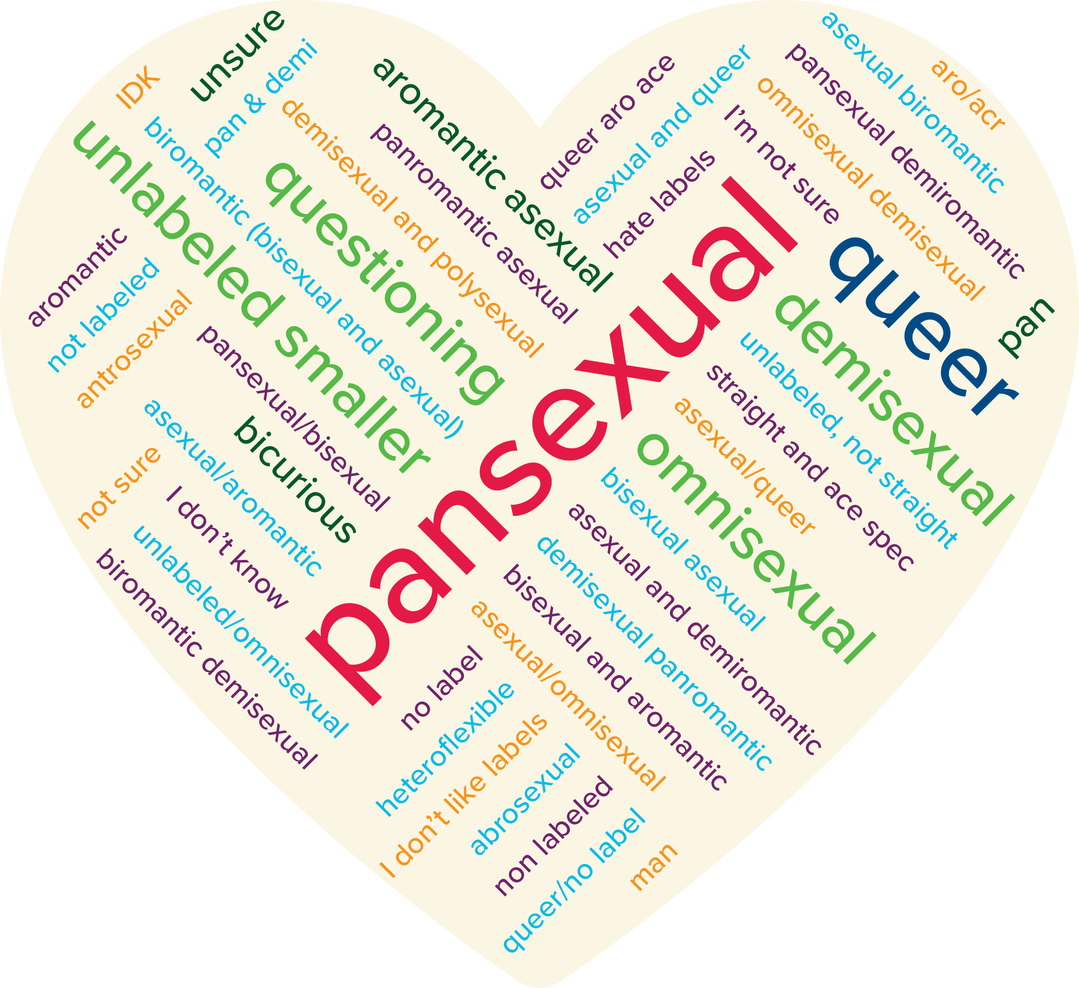
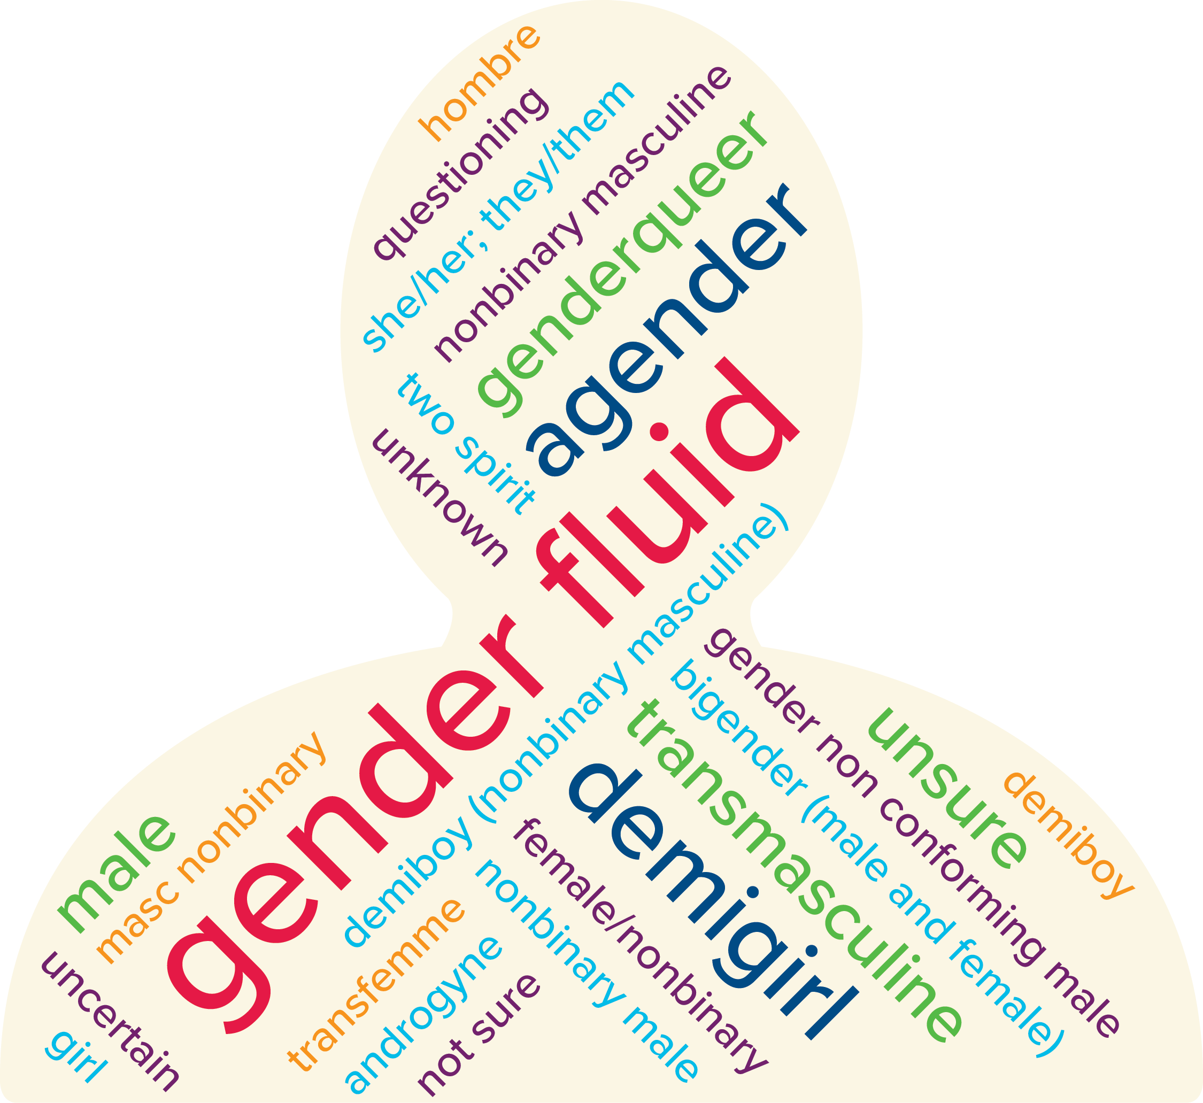
Gender and Sexuality Diversity
Students who chose to self describe used a diversity of descriptors
Notes:
Visual representation of how respondents identify

Slide 19
Limitations/Caveats
We are not able to do subgroup analysis for every single identity
Have to combine some gender/sexual orientation categories due to cell size issues
We follow a particular classification method and definitions for gender/sexual identities
E.g. Is transgender an umbrella term or a specific subgroup?

Slide 20
High School Experience

Slide 21
Self Rating of High School Social Experience

Slide 22
Belonging in High School

Slide 23
Experienced Bullying

Slide 24
Reasons Bullied: Gender and Sexual Orientation

Slide 25
College Plans

Slide 26
Educational Aspirations

Slide 27
College Major Plans

Slide 28
Worries About College

Slide 29
Worried about Discrimination on Gender

Slide 30
Worried about Discrimination on Sexual orientation

Slide 31
Worried about Finding Community

Slide 32
Worried about Adequate Support

Slide 33
Qualitative Analysis

Slide 34
Qualitative Analysis of Student Voices
The top themes expressed by gender diverse students for challenges in college are
Academics
Balancing and managing time
Only 10 listed discrimination
The top themes for excitements:
Learning and academics
Finding community
Gaining independence

Slide 35
What Gender Diverse Students Say
Content Warning: Suicide

Slide 36
Fears of Discrimination
“Transphobia”
“Political and social conflicts. I could die from hate crimes, but it's more likely that I end up killing myself. I struggle a lot with being trans and if not able to transition in college, I'm going to give up on everything. The political climate in Taiwan could reach a tipping point while I am in college. If that happens, I am likely going to drop everything to help my family.”
“lack of community due to discrimination”
“I think the biggest challenge will be standing up for myself.”
“Coming out to people around me.”

Slide 37
Excitement about College
“Being able to build a community for myself where I truly feel that I belong.”
“I'm excited to be myself. I live in a house of five. I'm the youngest of my three siblings, meaning I've had to share a room with my 23 year old sister since I was born. I've never had privacy and I never felt like I could be myself. To use broad terms, I could never properly express myself as a gay, trans teen. I can't wait to make new friends and enjoy my new found independence. “I’m [excited] about moving from home and working to establish my independence.”
“Getting out of my small area bubble and living on my own as my own person.”
“Finding likeminded people with similar interests and finding people who have the same sexual orientation”
Creating a healthy social circle, increased responsibility and freedom, and learning about specific subjects that interest me.

Slide 38
Questions and Comments

Slide 39
Thank you!
California Education Lab
Elizabeth Friedmann
Sherrie Reed
Paco Martorell
Scott Carrell
California Student Aid Commission
Marlene Garcia
Jessica Moldoff
Ryan Fuller
This research was supported by the College Futures Foundation and conducted in partnership with the California Student Aid Commission. The authors are also grateful for ongoing support from the Stuart Foundation to the California Education Lab. The California Education Lab at the University of California, Davis and Policy Analysis for California Education are also thankful for research dissemination support from the Bill & Melinda Gates Foundation. The findings and conclusions here are those of the authors alone and do not necessarily reflect the positions or policies of the funders or of the California Student Aid Commission.

